Slide 1



COMMIT TO CHANGE:
HOW TO INCREASE ACCESSIBILITY IN YOUR FAVORITE OPEN-SOURCE PROJECTS
Rose Franzen

Slide 2
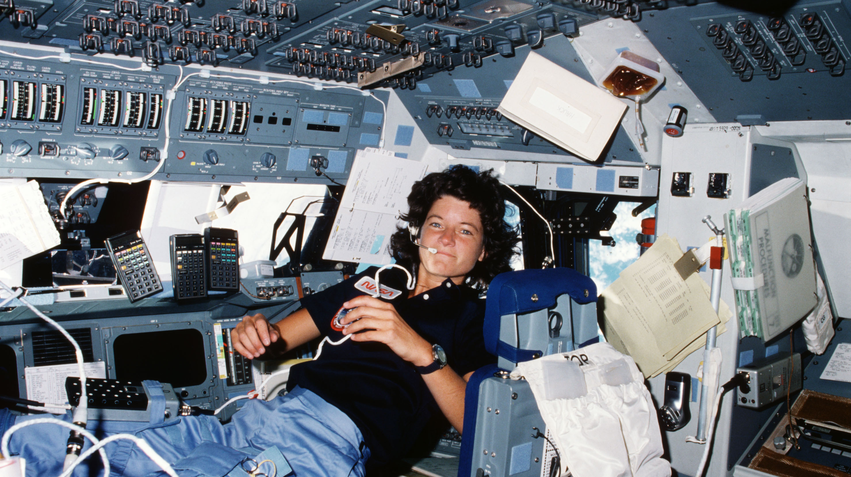
Sally Ride introductory hook
Image credit: NASA
Notes:
In 1983, NASA sent Sally Ride into space as the first American woman. In the lead up to her launch, the engineering team at NASA was working hard to ensure that everything went off without a hitch. Some time before the big day, the all-male team came to Ride to ask her if a sufficient number of tampons for a week-long mission was 100 tampons. Ride simply responded “No, that would not be the correct amount”. When pressed for more information, she told them they could cut that number in half, and it would still be over-prepared.
I love this story for many reasons, but one of them is that its fun to imagine what led up to the moment where they finally asked her for input. Clearly they knew that she had some needs they needed to accommodate, but how did they come to the number 100? These are engineers – did they do research on the absorbency and do some back-of-the-envelope calculations?
another reason is how apt this is for communicating
the most well intentioned group will do a laughable job when trying to meet the needs of a group they're not members of. Think of how much smoother would have gone if there was even just one menstruating person among the engineers. this drives home that to truly make something that meets someone's needs, someone with those needs should be involved
------
Another reason, is how apt this is at communicating even the most well intended effort meet needs of a group that isn’t included as a stakeholder can wind up being laughable. Think of how much smoother would have gone if there was even just one menstruating person among the engineers.

Slide 3
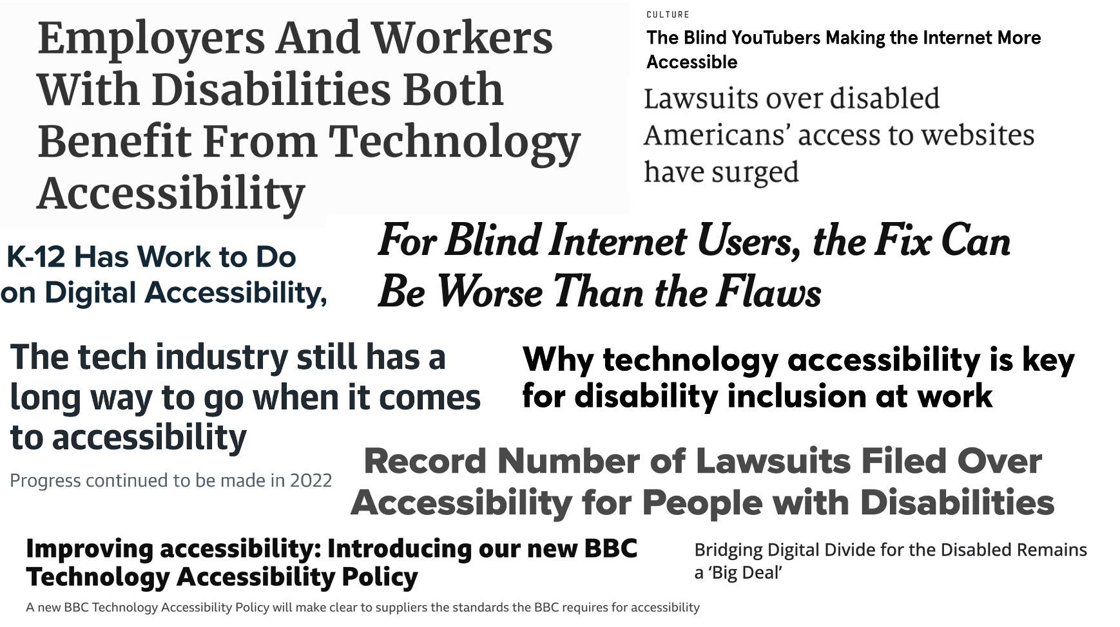
Growing acknowledgement of accessibility importance
Notes:
I’m not here to talk about tampons

Slide 4
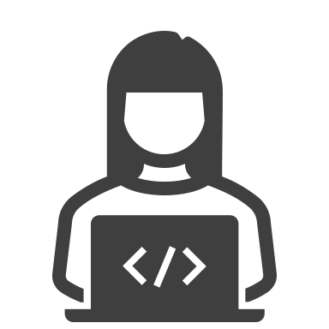


Development process overview
Notes:
As we all know, technology doesn’t just create itself, nor does data analyze itself (at least, not yet). So we have this process of click
an initial developer/contributor/maintainer who supports the creation of a tool or who is doing the data science. They produce the output, whether that’s an app or a piece of software or a report, which subsequently ends in the hands of the end stakeholder or user

Slide 5



Focus on end user
Notes:
In most of this dialogue, we tend to focus on that end user

Slide 6



By focusing on output or product
Notes:
And we generally do this by focusing in on a specific part of the process, which is that output stage

Slide 7
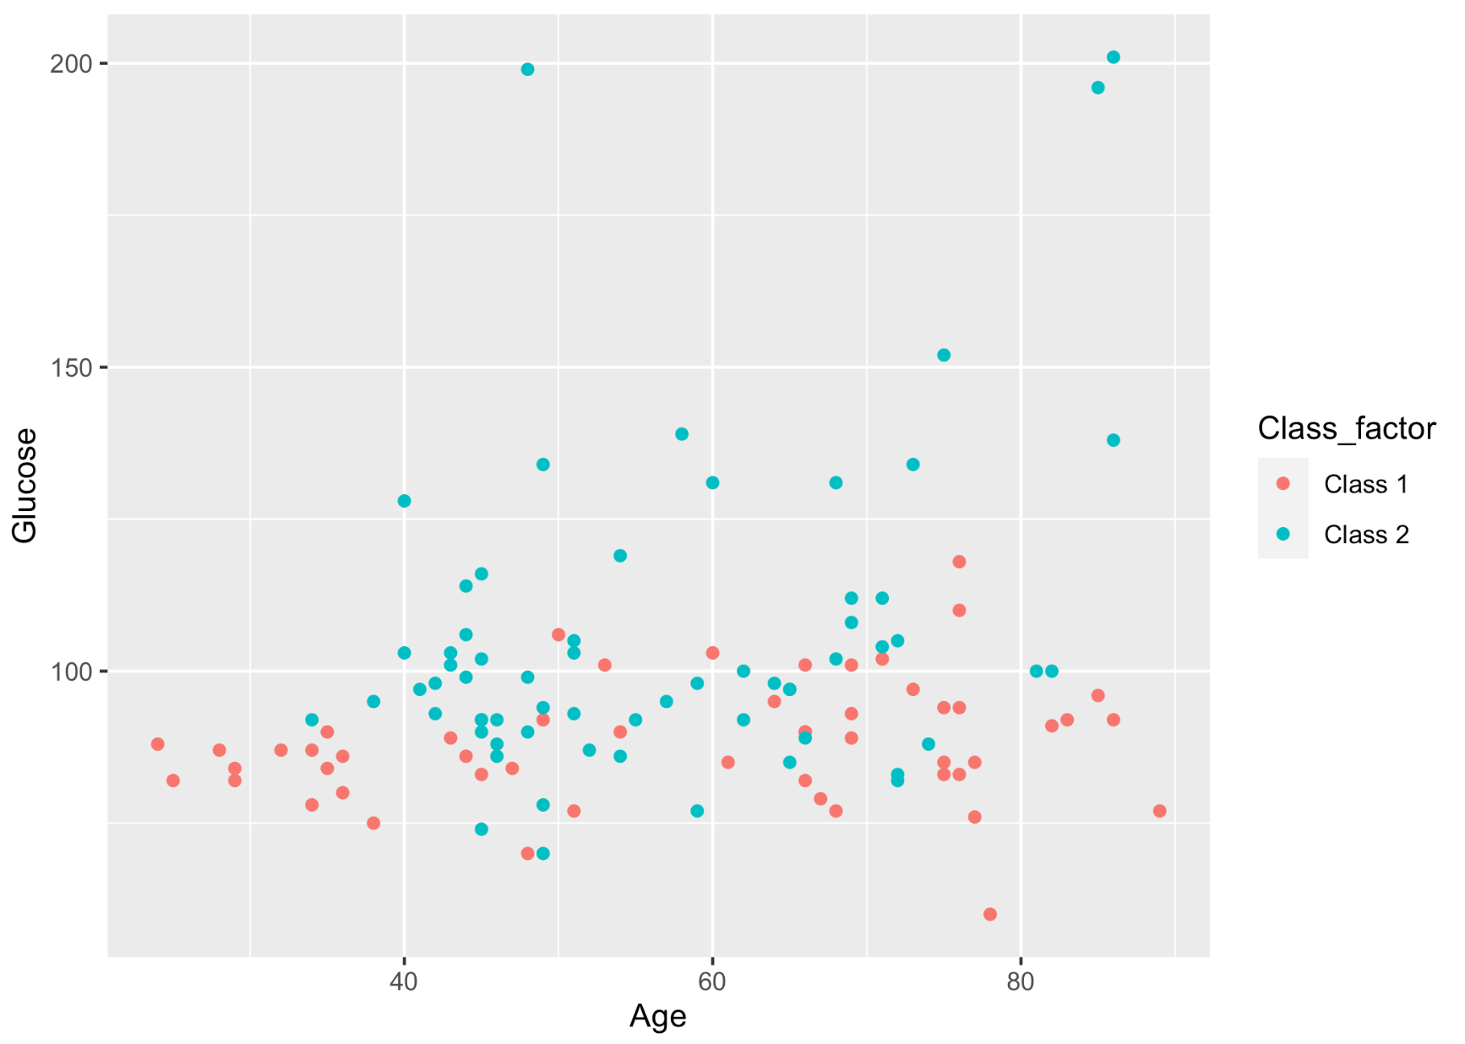
Data visualizations colorblind considerations
Notes:
Asking questions like “ can someone colorblind distinguish features of graph?”

Slide 8

Considering alt text
Notes:
“ included sufficient alt text for someone who requires non-visual access to this information?”
‘
wrong place to focus if we want to avoid being like that all-male engineering team at NASA

Slide 9


Focus on developer experience
Notes:
Instead of (only) focusing on the experience of the end user, divert attention toward the experience of the programmer or data scientist, working to reduce unnecessary barriers for disabled coders contributing to and use of open source projects

Slide 10

Think about developer tools
Notes:
to do this, we need to think about the tools, packages, languages, and programs that data scientists depend on in their daily work, and how we can improve their accessibility in order to ensure fewer structural barriers to the continued participation of members of the open source community with disabilities
-----
In the remainder of my talk, I’m going to discuss some simple steps that can be taken to begin improving the accessibility of the wide variety of open-source projects that data scientists and coders rely upon in their daily work. Importantly, these are steps that can be taken by anyone, without being an accessibility expert. I’m not going to get into any of the particularly technical aspects of tech accessibility. At the link to my slides, I’ve included a list of some resources. I haven’t had a chance to fully catalog my resources yet, so I intend to continue adding to this list even after the conference.

Slide 11
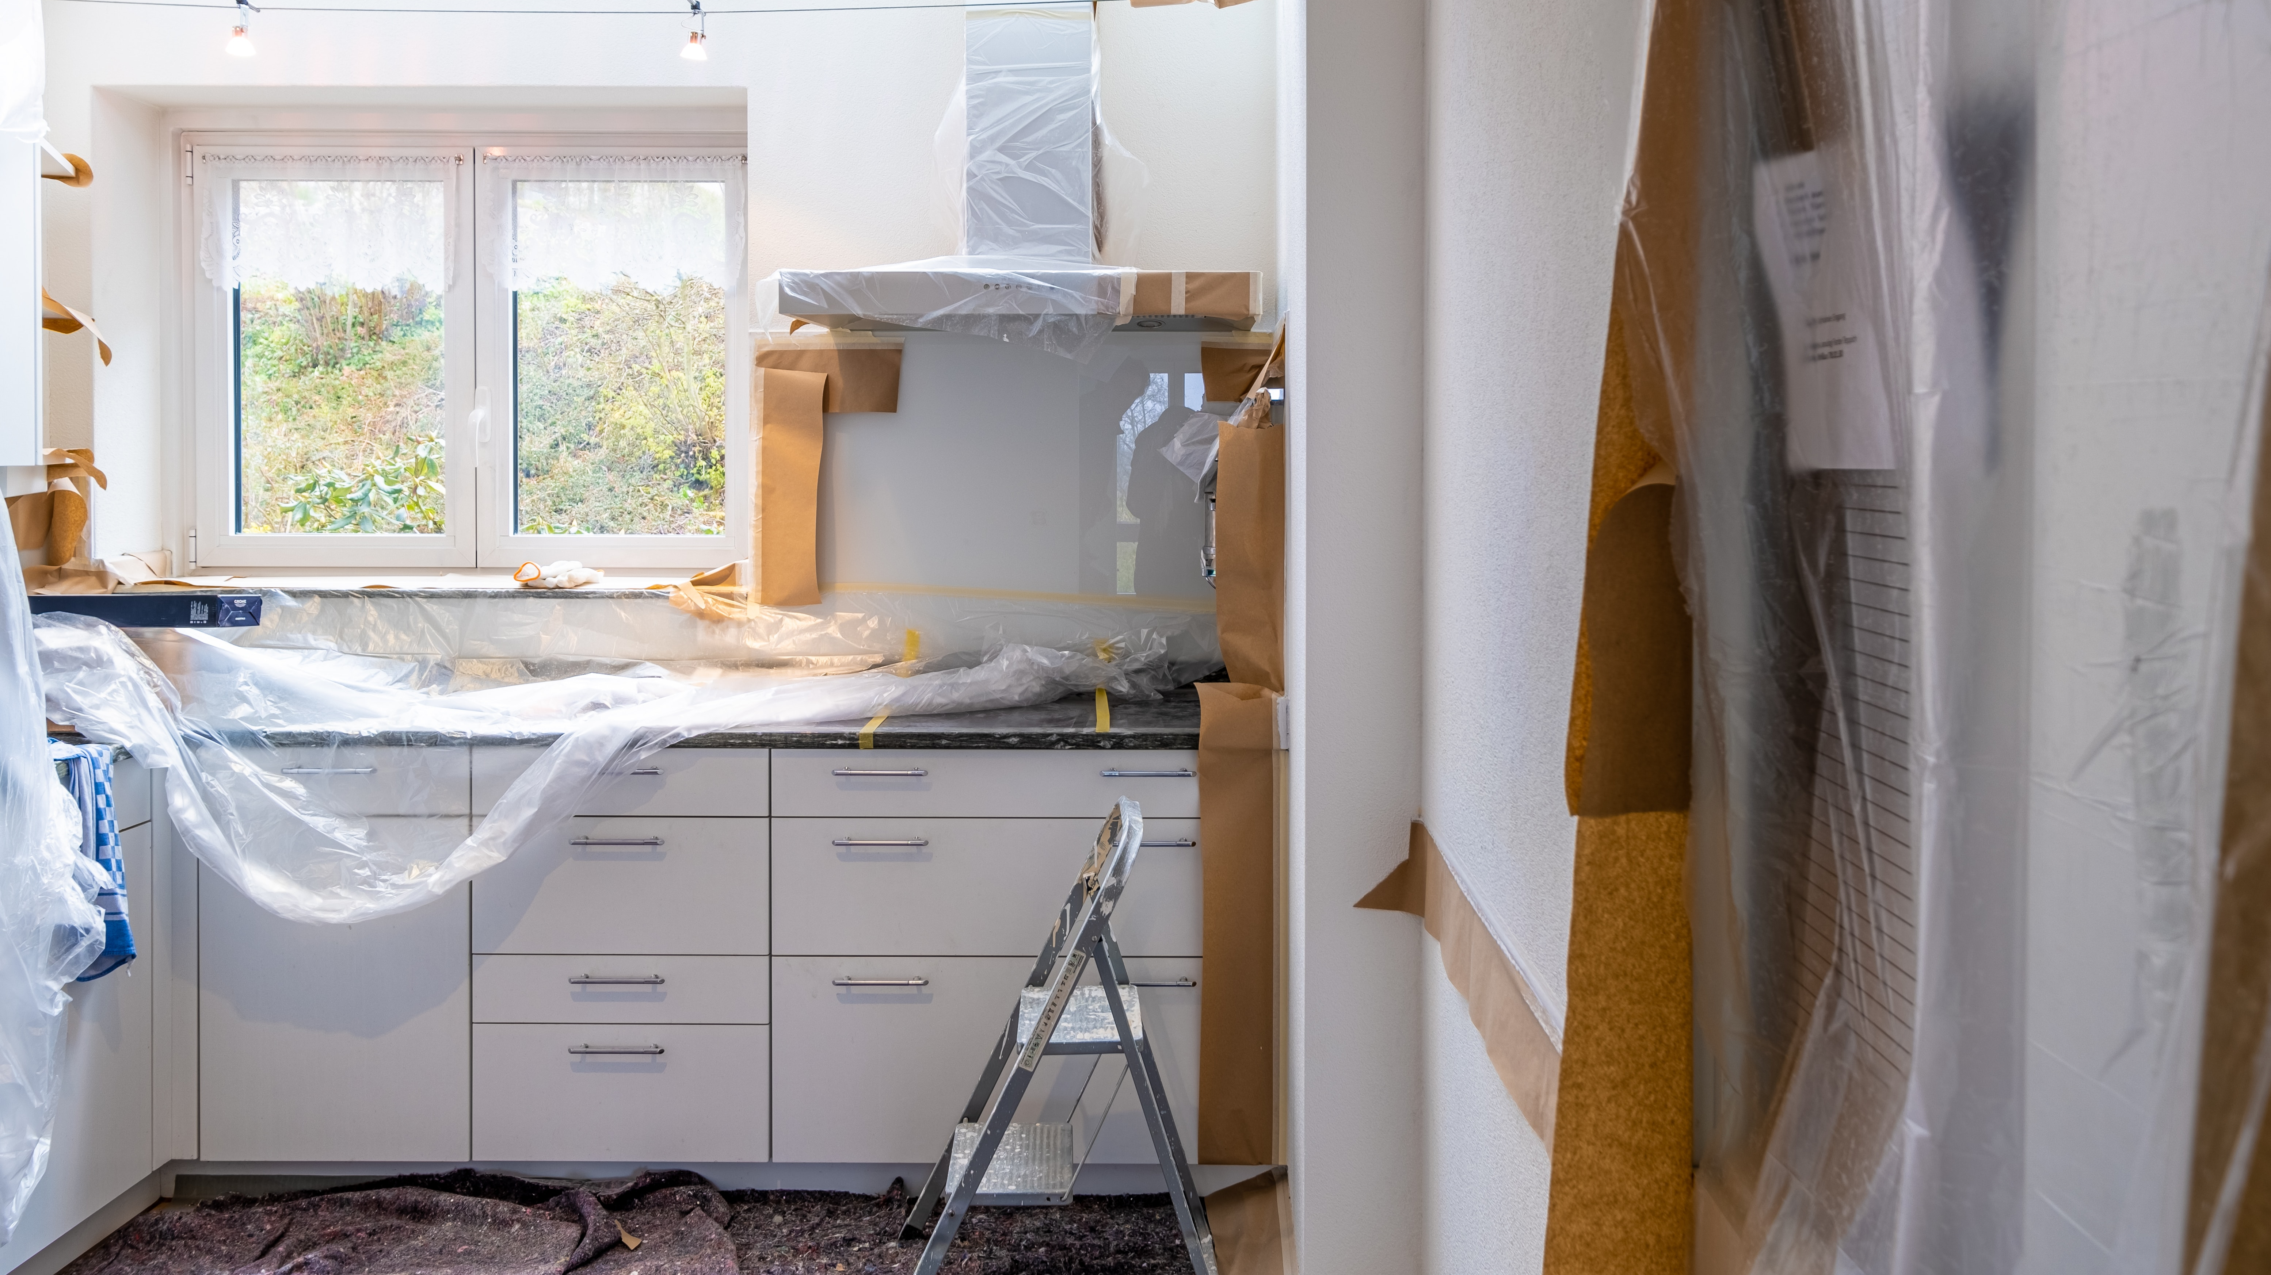
Kitchen renovation metaphor start
Notes:
Imagine you’re renovating your kitchen, and everything is going perfectly until you come across an issue. So You do some googling to try to diagnose what’s going wrong, and you think you’ve figured it out, and it seems like the problem can be solved as soon as you get your hands on a specific power tool.

Slide 12

Researching power tools
Notes:
so you spend significant effort researching and selecting the right tool, making sure it has the very specific set of features and capabilities that you need. Order it. Unfortunately, once it arrives

Slide 13
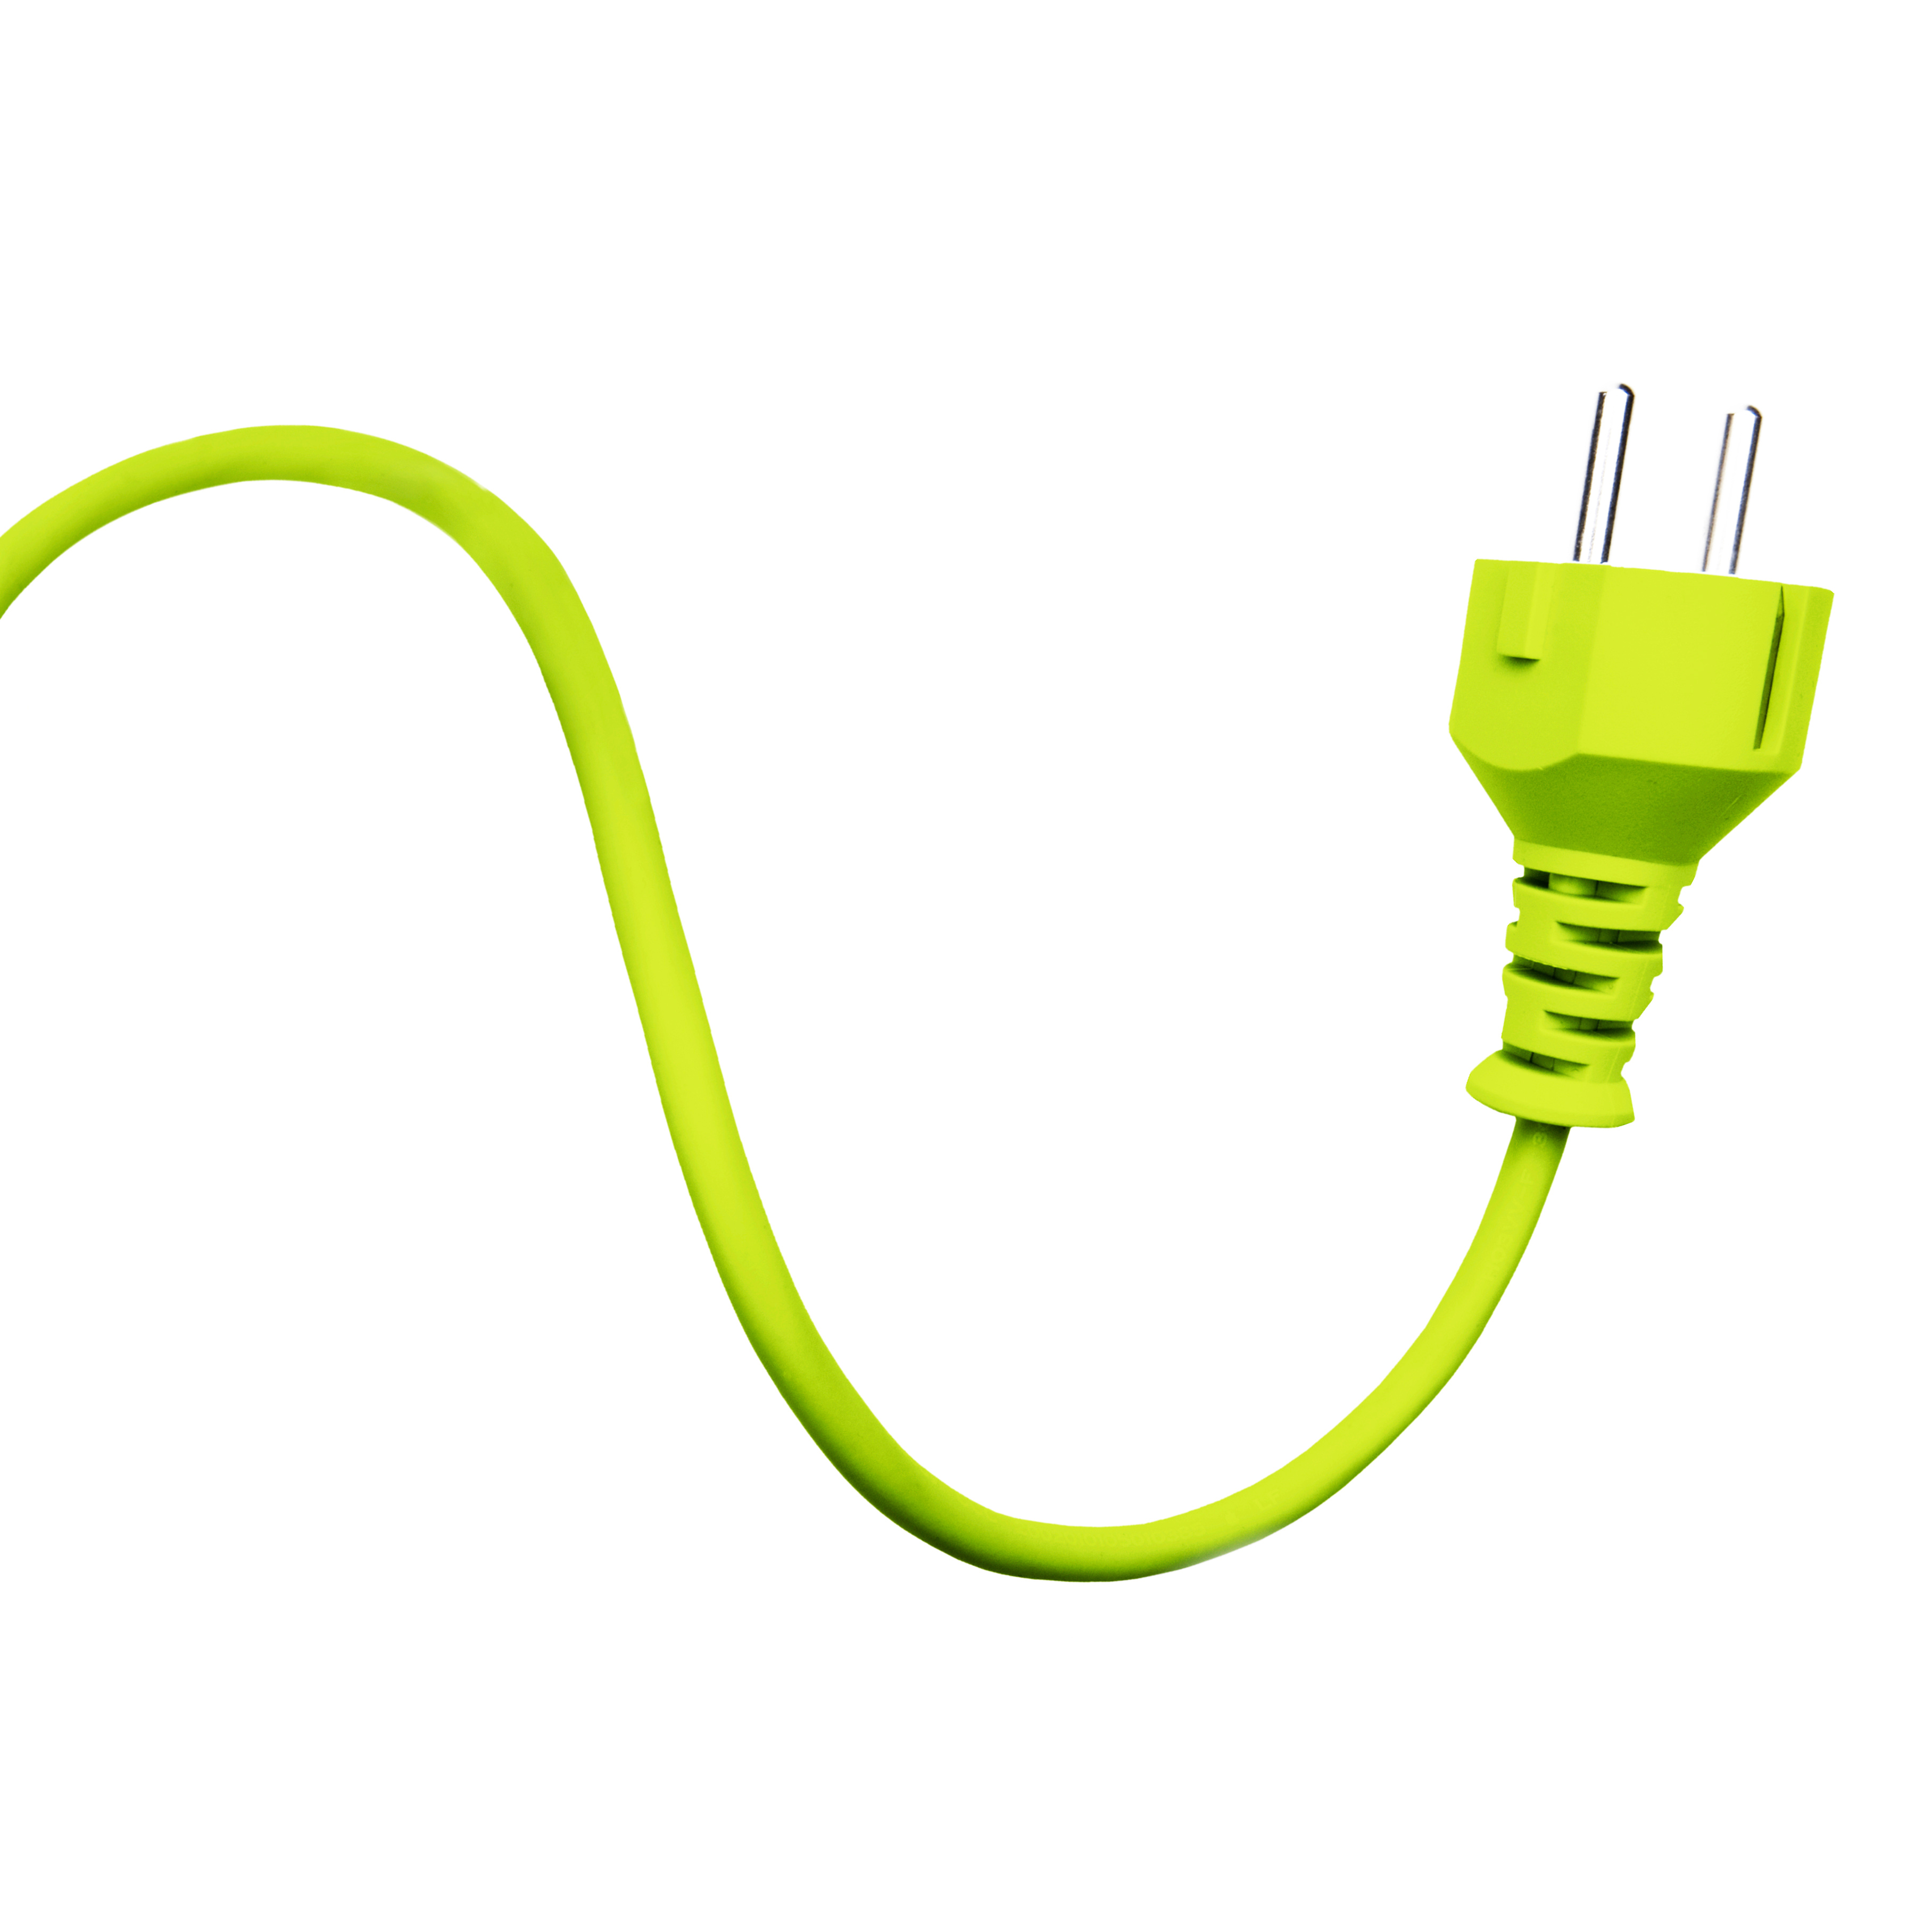
Power tool plug type
Notes:
It has a plug type F, which is used in much of Europe

Slide 14
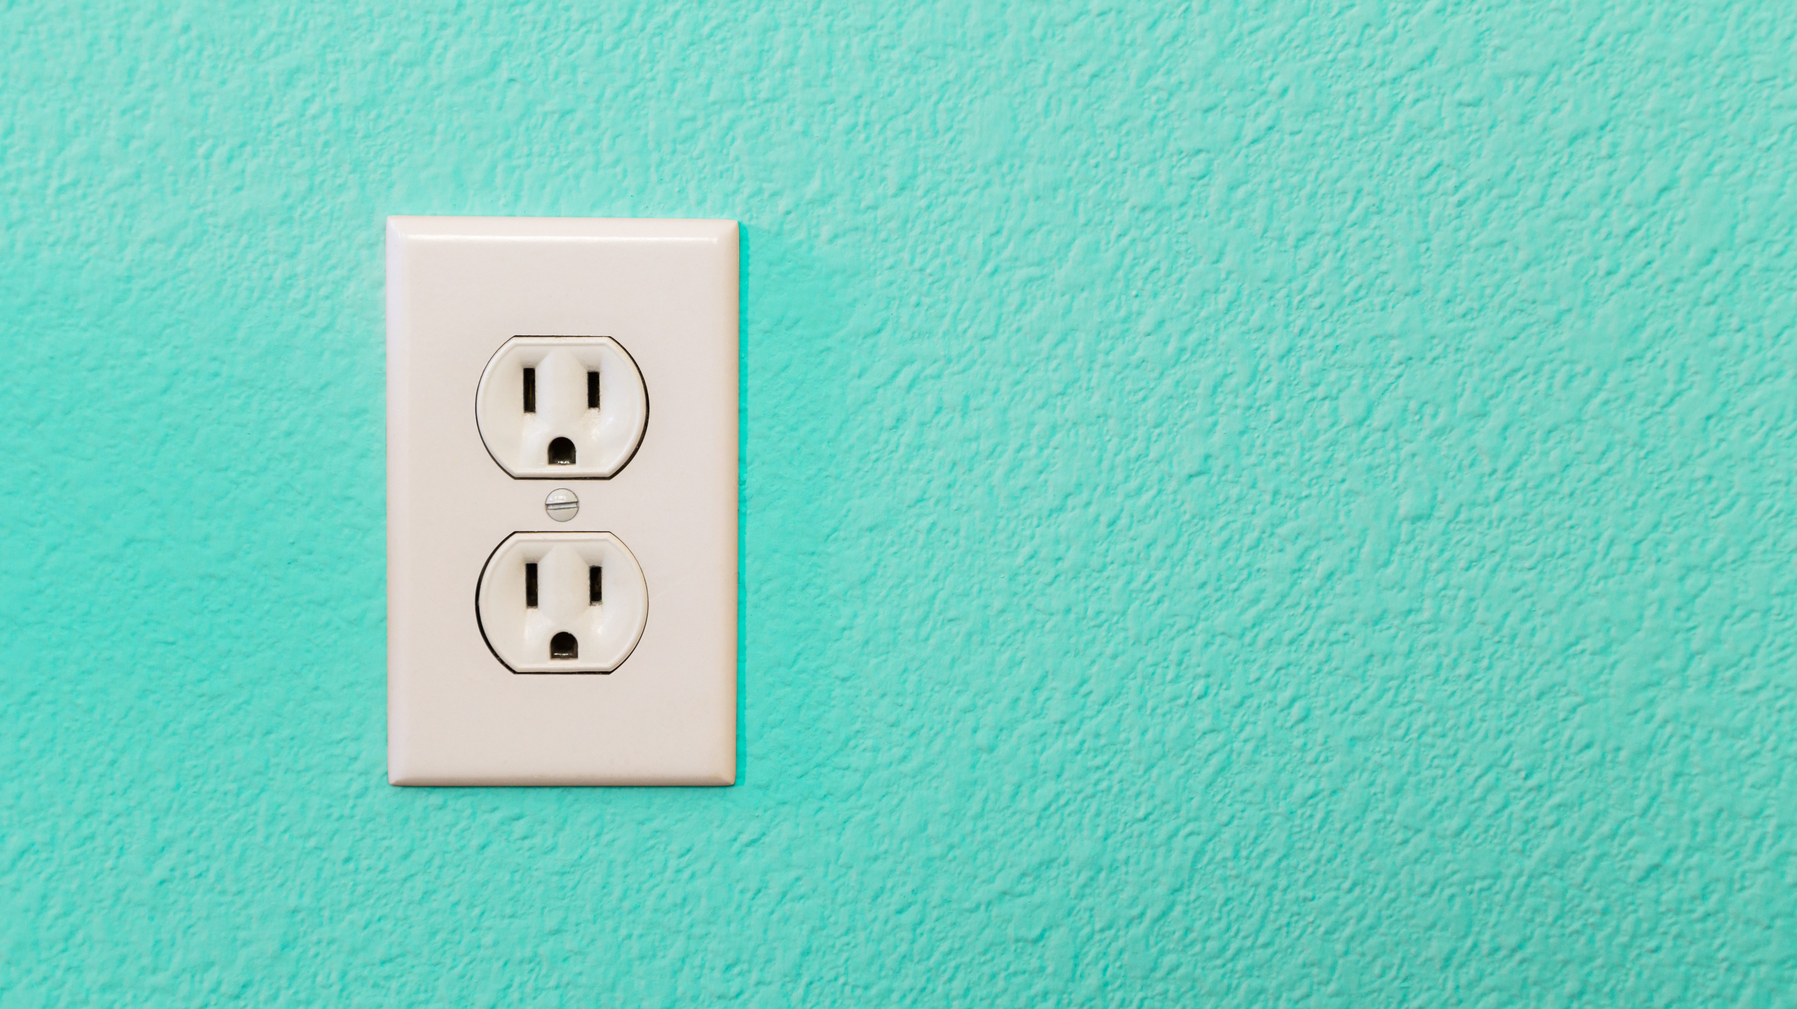
Incompatible outlet
Notes:
But you live in the US, and therefore your outlets only accommodate type A or B plugs.
Would have been great if this info was included in the product description, but it wasn’t. In fact, it’s not present in the description of almost any tools you can find. So your best bet is to just keep getting new tools, and trying them to see if they work.
If you’re thinking this sounds like a frustrating way to work, you’d be right!
It’s also the reality for many disabled data scientists when it comes to trying out open source tools in order to solve their programming problems. Where power tool = package, IDE, tool, and plug-outlet compatibility = accessibility.
IDE and outlet is screenreader
And unlike incompatible plug, unfortunately you can’t just go online an order a travel adapter that will magically solve. So you just have to keep trying tool after tool, hoping one works technically and accessibility wise.
Brings me to first thing we can do

Slide 15
1. Create “accessibility docs”
Notes:
Helps individuals quickly assess whether meets technical requirements and accessibility requirements

Slide 16
1. Create accessibility docs
High-level status of accessibility
List of known accessibility problems
Highlight accessibility features
Keyboard shortcuts
Options for error handling
Notes:
Here are some examples of things this might include… in my resources, I’ve got some examples of accessibility docs to spur further inspiration
Its ok to say that you don’t know! Even “it is unknown how compatible this is with screen readers” is more informative than saying nothing at all
Once you establish what is or isn’t known about a11y, its time to set up a way to get more information

Slide 17
2. Create a forum for feedback

Slide 18
2. Create a forum for feedback
Create an accessibility issue template or label
Valuable signal
Elevates importance
Crucial for identifying issues specific to the particular tool
Notes:
Opens space for those with most knowledge to make known what is needed.
Worth it to put effort into reprex?
Elevates the importance of accessibility; define it as a bug, not as a request. Culture shift.
Crucial for identifying the things that are specific to particular application/package/tool
At a minimum, can improve a11y docs. At best, easier for someone who has specific experience to come in and help out.
you might be thinking, all these examples are just setting the stage for improving accessibility -- how can I get started improving accessibility itself? / are there any ways I can improve accessibility without having a lot of specific knowledge? Or maybe you’re not involved in any projects as a maintainer, but you’d still like to add something as a contributor

Slide 19
3. Improve technical documentation
Notes:
Ok, I know, writing documentation isn’t exactly most people’s favorite parts of the job
Maybe there’d be fewer people in room if I had highlighted….
Let me show you just how huge of a barrier poorly accessible documentation can be
Lets say you are trying to get an overview of some complex process in order to better understand something you’re trying to debug. You bring up the documentation for the conceptual architecture of the project. I’ve done that for an actual technical documentation page. (not data sci ) Let’s hear what that experience would be like with a screen reader.

Slide 20

Demo of screen reader on documentation page
Notes:
MAKE SURE SCREEN IS SHARED WITH SOUND!!!!!!!!!
Just to be clear, the captions here are mine added for accessibility – these aren’t from the screen reader itself.
Click to advance slide before play – so cc aren’t on screen/distracting before start
In case you didn't catch it, I'm going to play it again play again
Hmm.. Maybe this documentation is still under construction? What does it mean by “graphic of” – is there any important info in there? Is is just an icon or logo? Huh….
I’m sighted, so I can go see what the page actually looks like. For those of us in the room who are sighted, Let’s take a look.

Slide 21
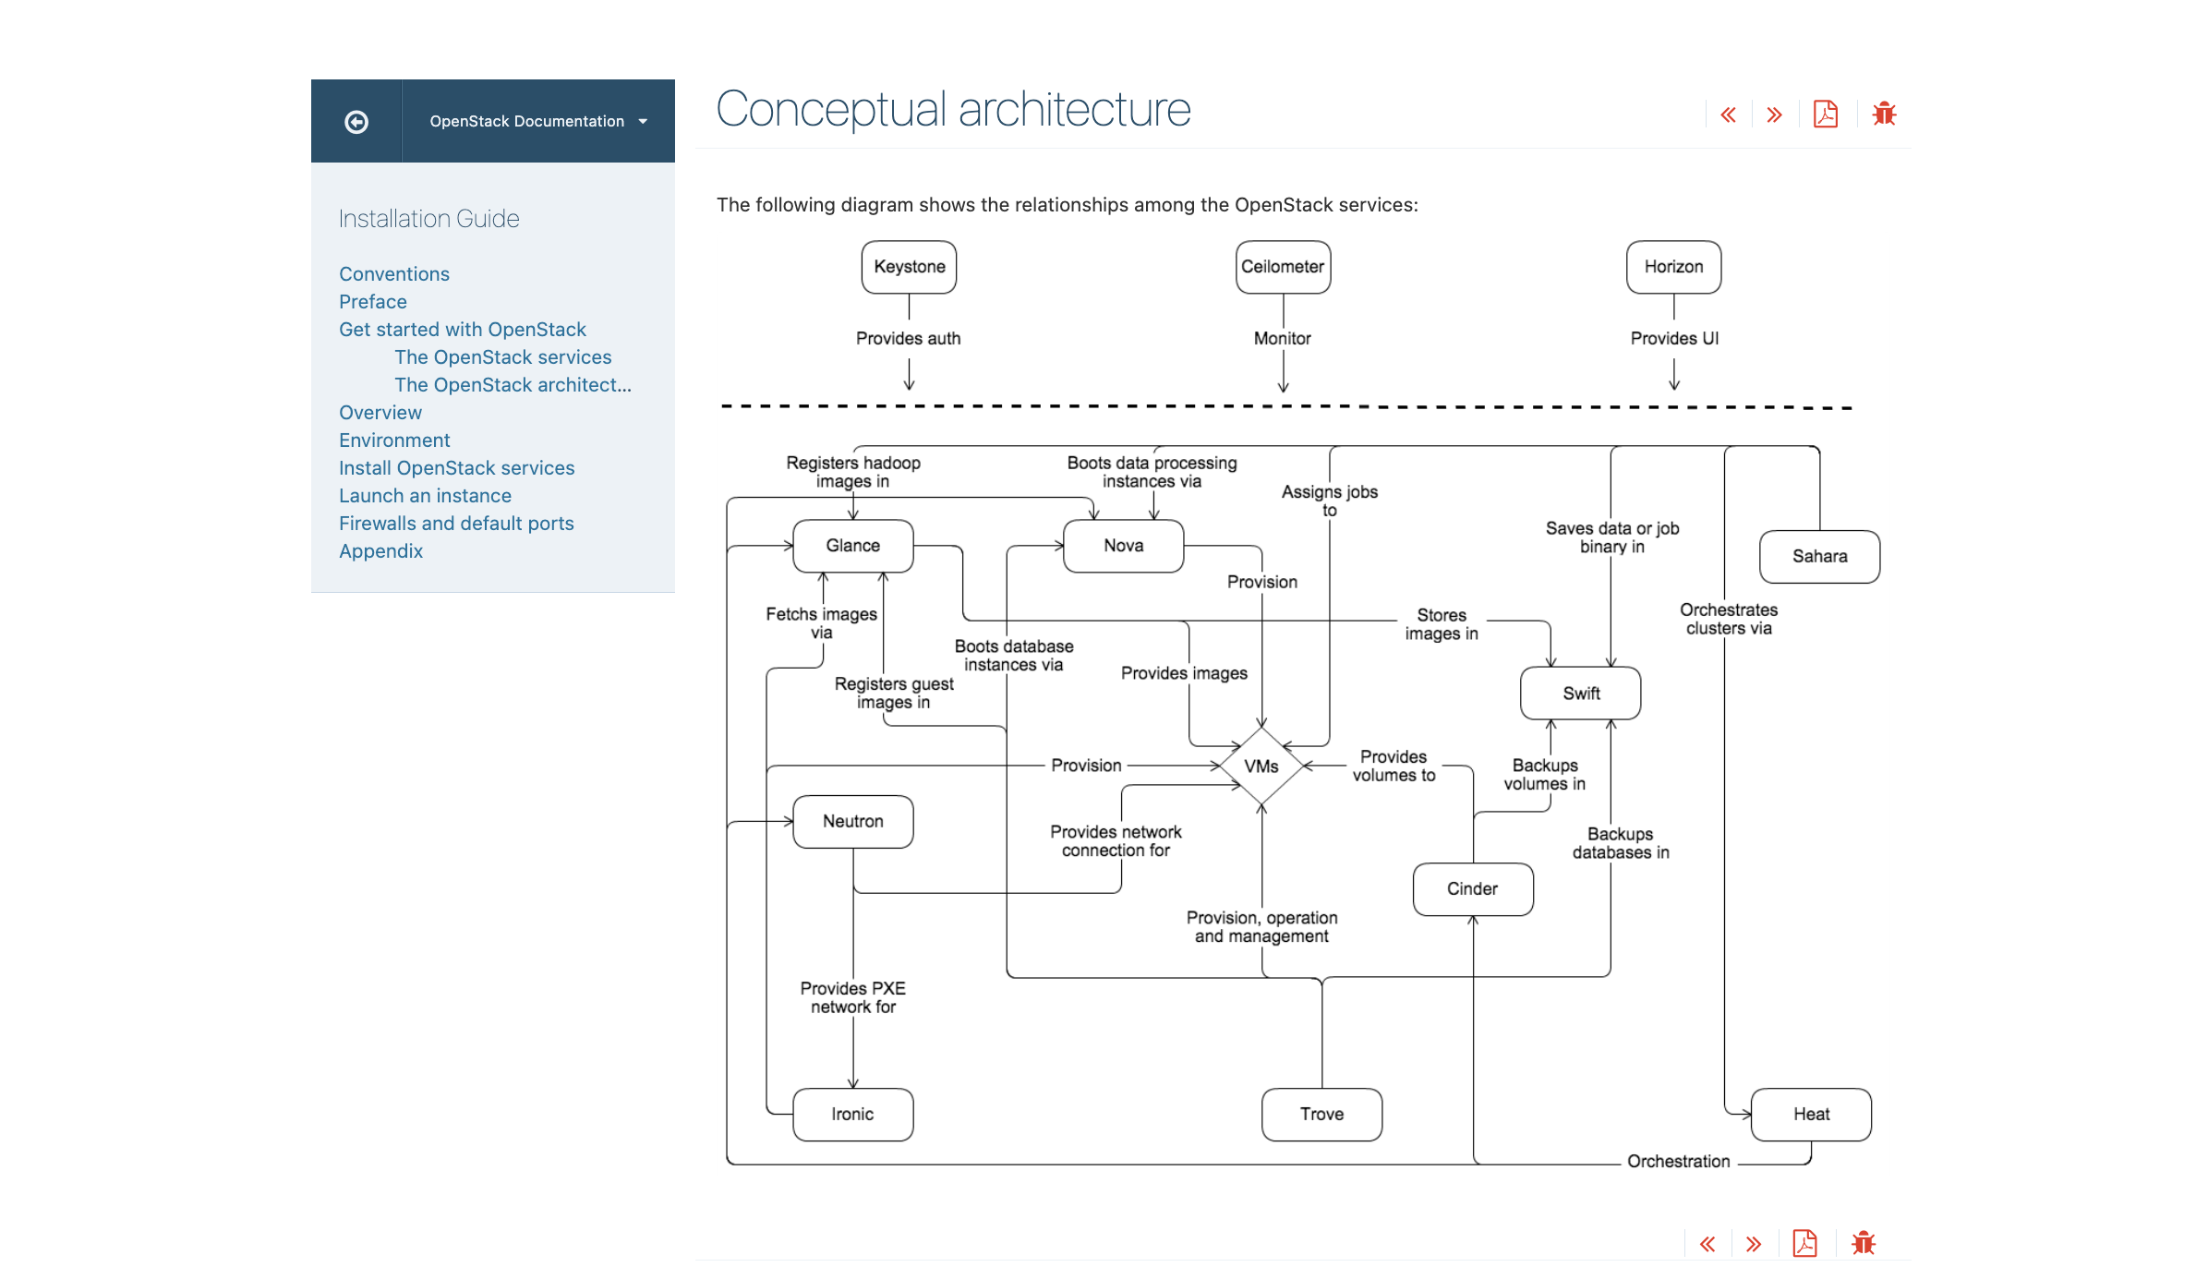
Documentation example
Notes:
Oh. Wow, that’s a lot of info
Describe what’s on the screen.
Alt text was just “graphic of open stack architecture” – really insufficient clearly
Brings me to first thing we can do to improve:

Slide 22


Alt text
Purpose of alt text
To serve the function of the image in its place
NOT to describe an image
Good test: use the plain text version of your documentation
Notes:
I’d like to correct a fundamental misunderstanding many people have about alt text. If you’re able to remember just this, you’re already well on your way to writing much more accessible text.
Click x3
Subtle, but crucial.
Click
Easy test without becoming a proficient screenreader user. Can you get everything you need just by using the plain text / raw, unrendered markdown? If not, your alt text is insufficient.

Slide 23
Informative link text
To learn more about a_really_cool_package click here.
Report bugs here
Learn more about a_really_cool_package.
Report bugs
Notes:
might seem insignificant difference, but a common way that users of screen readers will navigate is access a list of all links + go through.
click
Means will encounter without rest of sentence context.
What you want is something more like
Click

Slide 24
Consistent, logical heading structure
Use actual heading elements, don’t just stylize text
Don’t skip levels of heading hierarchy
Use CSS to change the visual appearance of the heading style instead
Notes:
Similarly, screen readers are often used to jump
Choose to read the text below heading if it sounds like target info – like skimming visually
Alternative is have entire doc read top to bottom linearly
This is also important for the cognitive scaffolding that it provides even for sighted developers

Slide 25
Clear, concise language
Break up walls of text where you can
Write in short sentences
Write in positive form
Use active voice
Notes:
Positive vs negative form example:

Slide 26
Review
Create “accessibility docs”
Create a forum for feedback
Improve technical documentation
Notes:
As a reminder, we talked about….
1meets technical and accessibility requirements
2. Using GH issue templates
3.

Slide 27
Time to commit
What’s one small, specific action you can take in the next 24-48 hours?
Notes:
Think of one specific action you can take in the next 24-48 hours to start improving a project you care about.
don’t necessarily need to be a core maintainer – many projects have clear instructions for how to suggest a change to documentation.
1st OSource PR I opened was improving alt text for Jupyter documentation.
Many of these fixes can be wonderful “good first issues” – if wanting more community engagement

Slide 28
Some ideas
Create an accessibility issue template on GitHub
Add a section to README with accessibility status (even if unknown)
Make a single issue
For something specific you’d like to fix
For auditing
Improve the alt text for a single image in the docs
Notes:
Set a reminder for yourself to make sure you do it. you’re not going to want to forget about this task, and that’s because as an additional piece of motivation, designed hex sticker

Slide 29
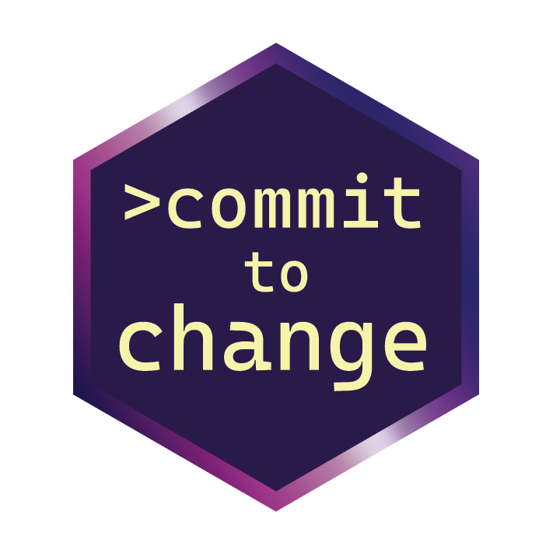
Hex sticker call to action
franzenr@chop.edu
github.com/franzenr/commit-to-change
Notes:
only way to get one is tag me in the comments of an associated PR or issue (or email me a screenshot), etc. click
If you’re here in person, try to come find me once you’ve done this to get your sticker. I know it’s the last day of the conference, so if you don’t find me before leaving, or you’re watching online, I’ll make my best effort to coordinate mailing these out to as many people as I feasibly can until I run out!
Thank you so much for your attention, and I look forward to seeing the first steps you take to commit to change.

Slide 30
Quick announcement before Q&A
Engagement Survey closes Monday 10/30
New question(s) related to disability
Notes:
Why are we asking these questions? We believe that having a more accurate count of CHOP employees with disabilities will improve our ability to advocate for continued improvements and resources. We also hope this information will also guide leaders who are making decisions on programs and services offered to employees.
We chose to collect this information through the Engagement Survey because it is anonymous. While you can self-disclose your disability status in Workday, we know that not everyone is comfortable adding this to their Workday profile. (Though CHOP does treat this information confidentially).
The Engagement Survey is administered by a third-party company, Press Ganey. Survey data is reported back to CHOP in an anonymized format. An important caveat is that any responses to open-ended questions are shared unedited. So if you include identifying information in your comments, someone may be able to guess who wrote it.

Slide 31
franzenr@chop.edu
Q & A
github.com/franzenr/commit-to-change
Notes:
only way to get one is tag me in the comments of an associated PR or issue (or email me a screenshot), etc. click
If you’re here in person, try to come find me once you’ve done this to get your sticker. I know it’s the last day of the conference, so if you don’t find me before leaving, or you’re watching online, I’ll make my best effort to coordinate mailing these out to as many people as I feasibly can until I run out!
Thank you so much for your attention, and I look forward to seeing the first steps you take to commit to change.

